Slide 1
Overview
SE overview : high level abstraction
  Technical perspective : chapter1,2
What is the next?
Refine process activities stepwise, but before dive to these refinement, we should give some necessary prerequisite knowledge.

Slide 2
Chapter 4
OO and UML distilled

Slide 3
outline
OO distilled
UML distilled
Thinking is foremost, detail is secondary.
2/8 Law

Slide 4
OO distilled
Why
What

Slide 5
Why OOADT?
OOADT: object-oriented analysis and design technology.
OOP: programming
OOD: object-oriented design
OOA: analysis
Attack Software crisis

Slide 6
Reasons for crisis
complexity is inherent characteristic
Intangible (creative effort)
Change
No effective technology and management approach

Slide 7
Today’s software
Increasing complex: enterprise level¹
change is inevitable: IBM SOA, proposes on-demand business
Notes:
铁路公司、 wallmart…

Slide 8
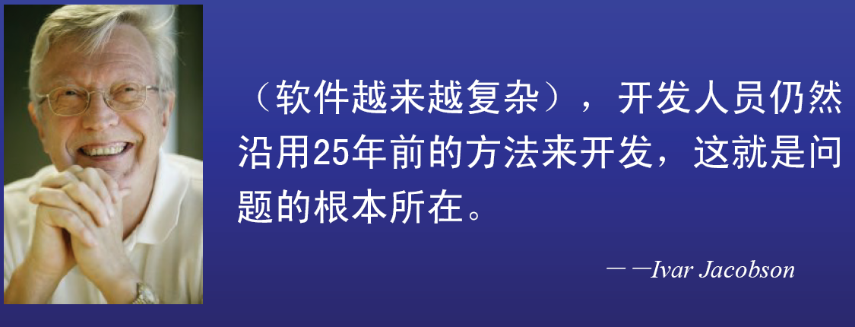
Root of the problem
Miller’s experiments: an individual can comprehend only about seven, plus or minus two, chunk information at one time.¹
Notes:
2+-7 law

Slide 9
Traditional Technology
SADT (structured analysis and design technology) has been succeeded in many software systems, particularly for small systems.
Thinking (唯心）
  The procedure is the origin of the world
  Procedure (function) oriented
  Data centered: Relational DB
  Program = DS + algorithm
Key problem: False assumption, the procedure is stable.

Slide 10
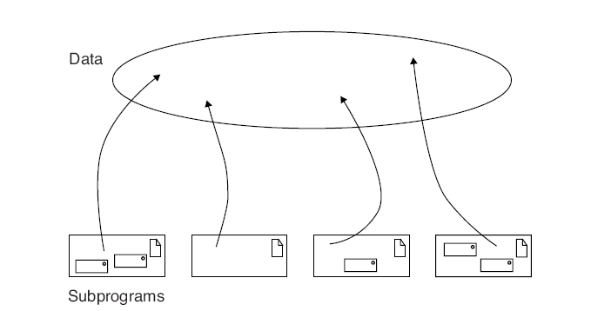
Traditional Technology

Slide 11
Traditional Technology (continued)
Today’s software makes it ineffective
  Complex overwhelm Procedure
  Constant change: butterfly effect due to PO’s data centered.
New technology comes in (OO) （唯物）

Slide 12
What is OO methodology?
OO brings revolution
  Cope with complexity
  Embrace change

Slide 13
OO’s brief history
OO programming language
  Smalltalk
  C++, Ada83, Eiffel
  Java,C#¹
  By far, object is nearest to real world
OO Framework
  Java EE
  .Net
OOD: object-oriented design
OOA: object-oriented analysis
UML: Unified modeling language
Notes:
1 c++ -→ java -→ c# , 少林和武当，同宗， 外甥多像舅
java do better in control complexity. Programming is about managing complexity: the complexity of the problem you want to solve, laid upon the complexity of the machine in which it is solved.
fundamental intent of java, caring about reducing the time and difficulty of producing robust code. In the early days, this goal resulted in code that didn’t run very fast (although this has improved over time), but it has indeed produced amazing reductions in development time—half or less of the time that it takes to create an equivalent C++ program.

Slide 14
Review
Software is increasing complex and traditional PO (procedural-oriented) can not effectively manage. (why?)
More worse, PO can not efficiently adapt to inevitable change
OO comes in for coping with these, among others problems

Slide 15
OO’s Thinking
The object is origin of the world
OOP = object + object + message
Objects are relatively independent and autonomous.
An interaction among objects forms a procedure

Slide 16
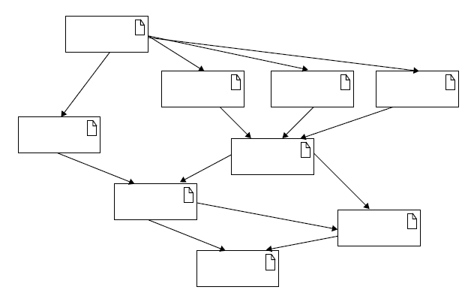
OO’s Thinking
object

Slide 17
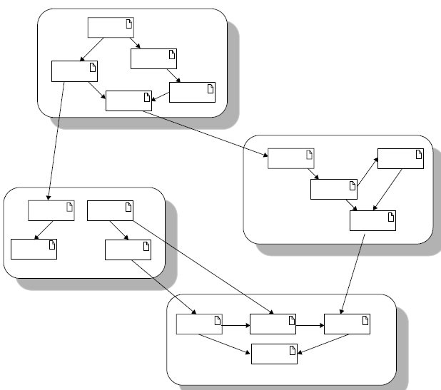
OO’s Thinking

Slide 18
Key characteristics of OO
Encapsulation: an object contains attributes and operations¹
Inheritance: hierarchy system
  Subclass can inherit attributes and operations of its super class
  reuse
Polymorphism ?
  one abstraction has many implementation
Message:
Notes:
收起咸猪手

Slide 19
OOP’s advantages
Human centered: understanding problem and solving it is consistent…
Simulate real world naturally.
Real world and computer world is seamless.
  Correctness/robustness
  Extensibility
  Reusability
  Compatibility
  …

Slide 20
OP versus OO
In general, OO is better than OP
OO is more difficult than OP
OO is not heal-all
OO do well in complex, interact-base system
PO do well in computation-intensive system
No panacea!

Slide 21
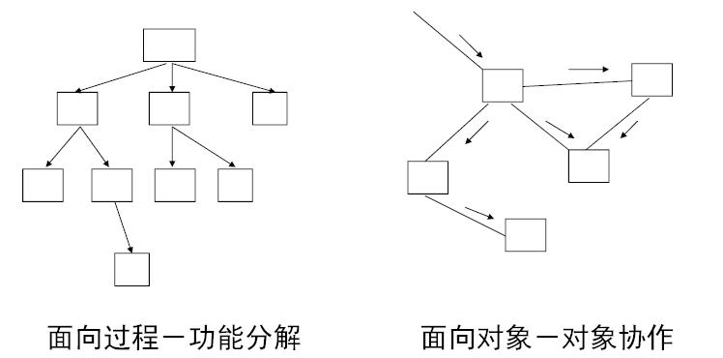
OP versus OO

Slide 22
OO’s nature---comment from a big shot
Booch: My objective with OO programming never was reuse. Instead, objects for me provide a means for dealing with complexity. The issue goes back to Aristotle: do you view the world as processes or as objects? Prior to the OO movement, programming focused on processes -- structured methods for example. However, that system reached a point of complexity beyond which it could not go. With objects, we can build bigger, more complex systems by raising the level of abstraction -- for me the real win of the object-oriented programming movement

Slide 23
Challenges confronted by OO
How to identify objects and its relation and interaction for a specific problem?
  Which ,how many, why these objects?
How to map real world into computer world step by step?
How to represent these mapping?
UML is a, by far, the most effective tool to meeting these challenges. It acts as a golden bridge between …

Slide 24
UML distilled
WWH
Why
What
How

Slide 25
Why UML
UML is de facto for OO¹
Notes:
软件开发人员的五线谱

Slide 26
Why UML (continued)
Richard Mark Soley, Chairman and CEO, OMG
Since its original introduction in 1997, the UML has revolutionized software development. Every integrated software development environment in the world--open-source, standards-based, and proprietary--now supports UML and, more importantly, the model-driven approach to software development. This makes learning UML, critical for all software developer¹.
Notes:
五线谱 for software developers

Slide 27
Why UML (continued)
UML is a modeling language.
Model is a simplification of the real thing.
Software developing process is virtually a modeling process.
If you are working on a system beyond "Hello, World," then having UML in your toolbox of skills is a must .This is where UML comes in.

Slide 28
Why UML (continued)
UML is a good modeling language.
UML is, for the time being, the best modeling language.

Slide 29
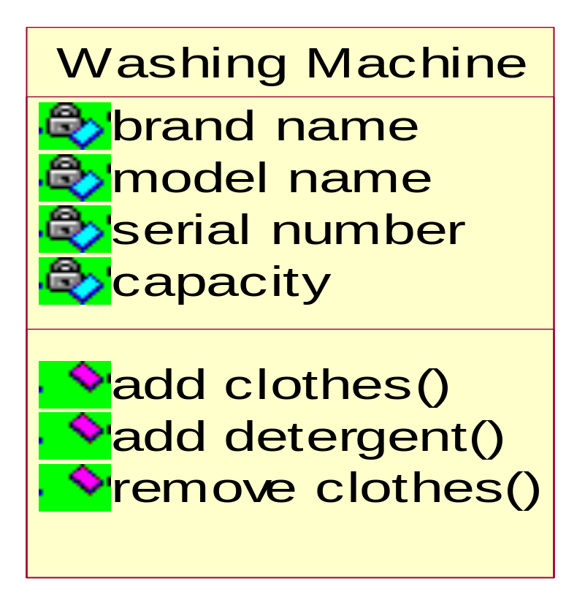
Why UML--- other modeling languages
What is in a modeling language?
  Notation: pseudo-code, actual code, pictures, diagrams, or long passages of description; in fact, it's pretty much anything that helps you describe your system. For example:

Slide 30
Why UML--- other modeling languages
What is in a modeling language?
  Notation: notation is not the whole story
  Semantic: The descriptions of what the notation means are called the semantics of the language and are captured in a language's meta-model.
Modeling with code
  Overload with detail
  Too jargon
  Can not see the forest for the trees
  ….
  Exmaple: exampleForModelingWithCode.doc

Slide 31
Why UML--- other modeling languages
Modeling with informal language
  Ambiguous
  Computer can not read
  …
UML is balance of the two extreme ends
  It orient both computer and human
  It's a formal language : Each element of the language has a strongly defined meaning, so you can be confident that when you model a particular facet of your system it will not be misunderstood.
  It's the standard.

Slide 32
Why UML--- other modeling languages
  It's concise: The entire language is made up of simple and straightforward notation.
  It's comprehensive: It describes all important aspects of a system.
  It's scaleable: Where needed, the language is formal enough to handle massive system modeling projects, but it also scales down to small projects, avoiding overkill.
  It's built on lessons learned: UML is the culmination of best practices in the object-oriented community during the past 15 years.

Slide 33
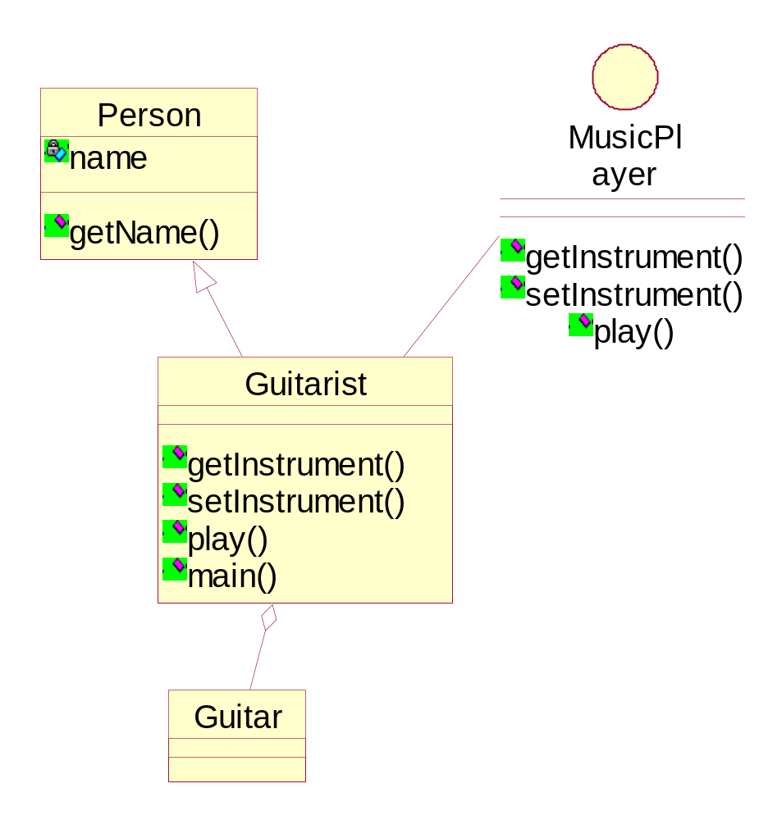
UML modeling for the above code example

Slide 34
Review
OO
  OOP
    C++, C#, Java, Ruby……
  OOA & OOD
    How to represent ?
      UML
        五线谱 for software developers

Slide 35
Thinking is foremost important
UML is just a good tool, what is most important is to use tool express OO’s thinking.
UML is only symbolizing and embodiment of OO’s thinking.
A Fool with a Tool is Still a Fool.
Owning a hammer does not necessarily make one an architect.
买椟还珠
授人以渔 Thinking in Java,…

Slide 36
Thinking versus tool( 技 和 道）
Thinking leads to tools, tools are media to represent thinking.
Tools are best practices deriving from the given thinking.
Tools are important for efficiently solving problems, but
We, as master candidates, should explore thinking implied in these tools or methods.

Slide 37
What --Introduction the UML
UML is acronym of Unified Modeling Language
  Language
    Word: basic elements, notation
    semantic
    Grammar: rules
  Unified: easy to communication
  Modeling: simplification of the original thing

Slide 38
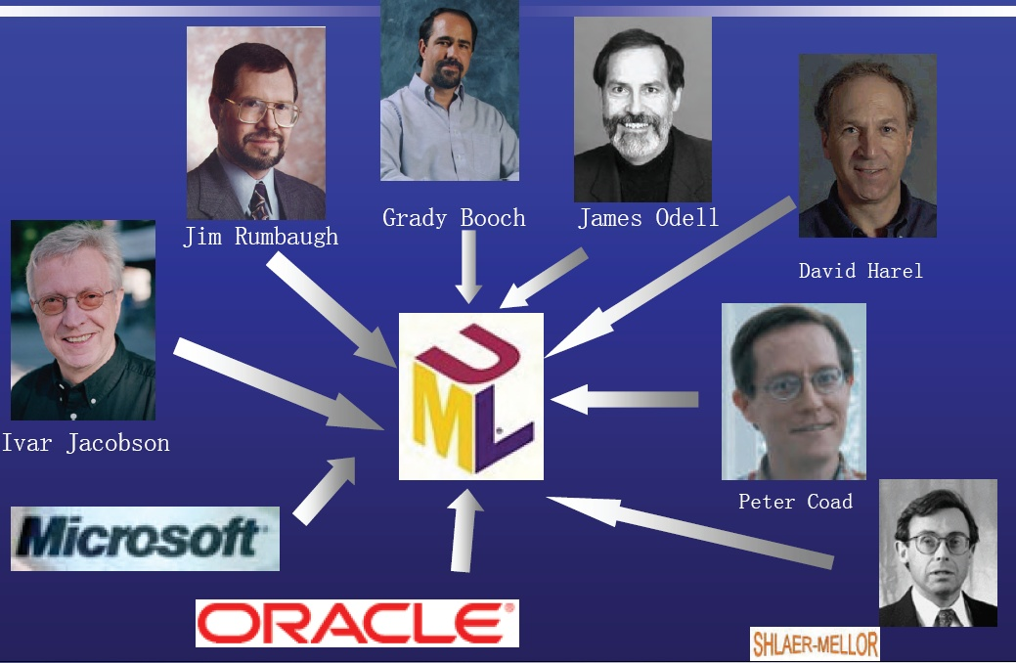
Unified process---standard

Slide 39
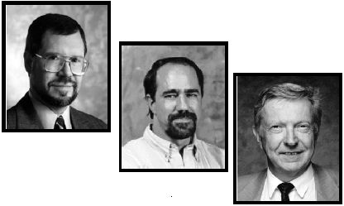
three amigo
Jim Rumbaugh
Ivar Jacobson
Grady Booch

Slide 40
The significance of Unified
Facilitate to communication
  Teamwork: different group, easy to communication.
Formal standard: component
Readable for human and computer

Slide 41
UML definition
UML——The Unified Modeling Language (UML) is a language for specifying, visualizing, constructing, and documenting the artifacts of software systems, as well as for business modeling and other non-software systems
  visualizing
  specifying
  constructing
  documenting

Slide 42
UML is heavy-weight tool
How we cope with the complex tool?
2/8 principle
  mythical 20 percent of UML that helps you do 80 percent of your work.
  You can model 80% of most problems by using about 20 % UML
  We focus on those 20%
Law of parsimony : less is more.
Notes:
Nobody, not even the creators of the UML, understand or use all of it. Most people use a small subset of the UML and work with that. You have to find the subset of the UML that works for you and your colleagues.
Nobody, not even the creators of the UML, understand or use all of it. Most people use a small subset of the UML and work with that. You have to find the subset of the UML that works for you and your colleagues.
Nobody, not even the creators of the UML, understand or use all of it. Most people use a small subset of the UML and work with that. You have to find the subset of the UML that works for you and your colleagues.

Slide 43
Law of parsimony
Since ancient times, the most talented architects and the most gifted designers have known the law of parsimony. Whether it is stated as a paradox ("less is more"), or a koan ("Zen mind is beginner's mind"), its wisdom is timeless: Reduce everything to its essence so that form harmonizes with function. From the pyramids to the Sydney Opera House, from von Neumann architectures to UNIX and Smalltalk, the best architects and designers have strived to follow this universal and eternal principle.

Slide 44
A UML model example: Class Diagram

Slide 45
UML IDE platform
Rational Rhapsody http://www01.ibm.com/software/awdtools/rhapsody
Enterprise Architect http://www.sparxsystems.com/
Borland Together
ArgoUML
StarUML
Microsoft visio
……

Slide 46
An example with UML
import java.awt.Graphics;
class HelloWorld extends java.applet.Applet
{
public void paint(Graphics g)
{
g.drawString(“Hello, World!”, 10, 10);
}
}

Slide 47
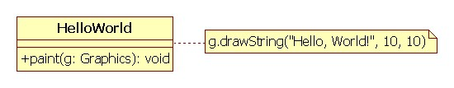
HelloWorld class diagram-1
类
注释

Slide 48
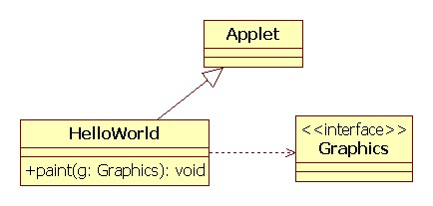
HelloWorld class diagram-2
继承关系
依赖关系

Slide 49
How using 20% UML models
OO is human-centered, we in fact need modeling four fundamental elements for common system.
Human 人(系统）¹
Business 事
Entity 物
Rule 规则
人做事情；做事情需要物并产生一些物；做事情需要遵循一定的规则。人驱动系统；事体现过程；物记录结果；规则是控制。
Notes:
越来越多的工作由系统代替人。

Slide 50
OO generic developing software process
Identifying stakeholders:
  “human” ，organization
    Top priority person first
Exploring goals of each actor using the system being developed.
  Human’s vision, or dream leads to what business
  Business. Refine vision to specific business.
Realize these goals with software.
  finding objects needed for these goals
  Interaction between objects to reach each goal

Slide 51
Modeling OO developing process with UML
Modeling human with actors
Modeling business with use case
Modeling entity with object/class diagram
Modeling interaction with sequence diagram, etc.

Slide 52
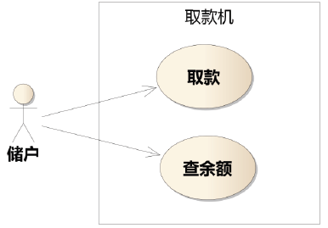
Two typical examples
Bank ATM
  Human: customer
  business: take money, save money, change password etc.
  Entity: card, ATM
  Rules: take at most 5000Y one day.

Slide 53
Review
Why UML
What UML
How UML
  Human
  Business
  Entity
  Rule

Slide 54
Two typical examples (continued)
Library book management
  Human: borrower, book administrator, etc.
  business: borrow book, return book, search book, reserve book.
  Entity: card, book, etc.
  Rules:

Slide 55
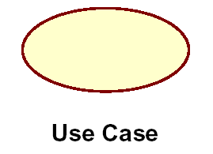
modeling “business” with use case
business is source of software requirements
Use case modeling system functional requirements.
First look at a use case diagram:

Slide 56
what is a use case?
A use case is something an actor wants the system to do, describes behavior that the system exhibits to benefit one or more actors.
A specification of sequences of actions, including variant sequences and error sequences, that a system, subsystem or class can perform by interacting with outside actors.

Slide 57
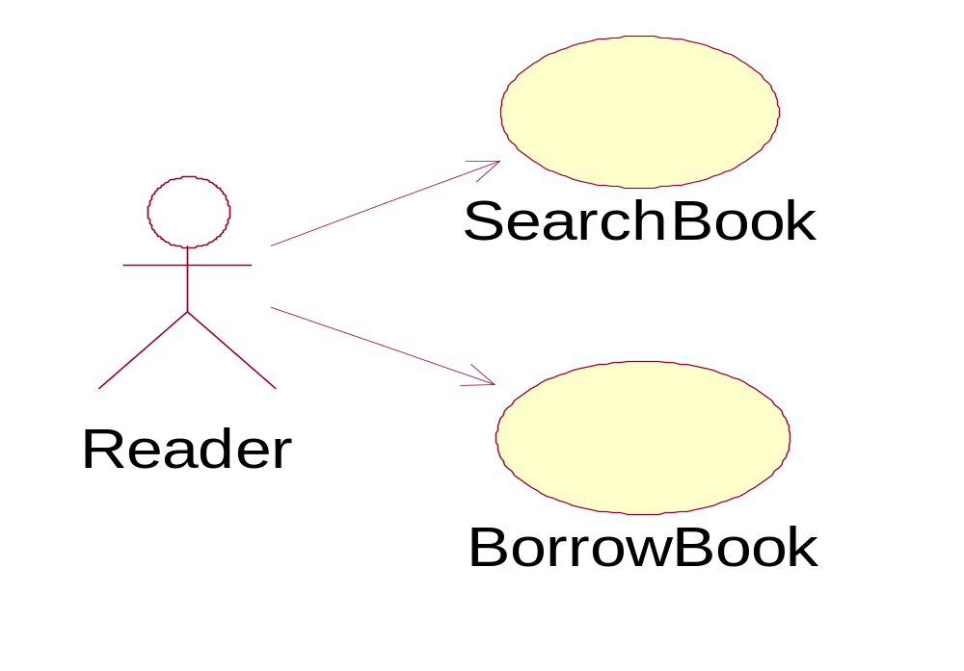
modeling “business” with use case

Slide 58
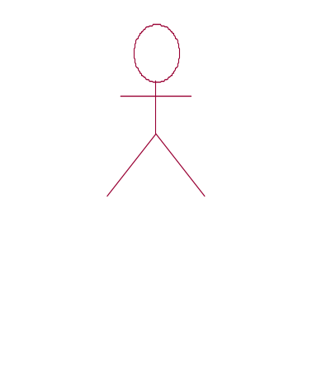
modeling “Human” with Actor
Human is center, a system does not meet human’s requirement is useless.
UML model: actor
Actor: anything interacting with system to do business.
First look at an actor:

Slide 59

What is an actor
An actor is someone or other system outside the system that interacts with the system.
Actor: roles played by people or systems that use the system, which may be:
  a person ( the most intelligent system)
  another system, and time etc.
Actor represented with a stick-man.

Slide 60
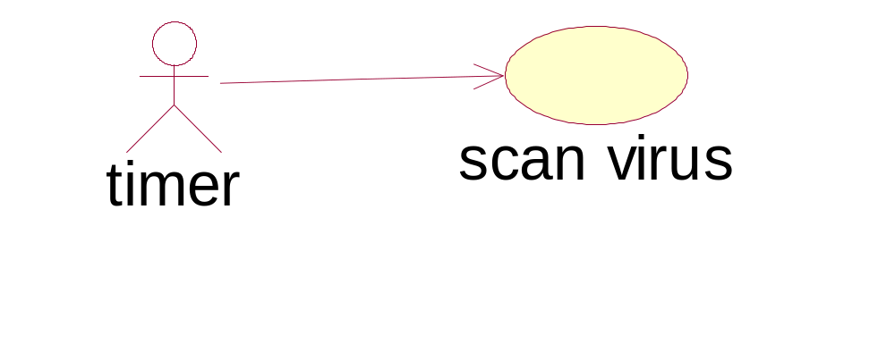
“Time” actor”
When you need to model business that happen to your system at a specific point in time but which don’t seem to be triggered by any actor, you can introduce an actor called Time. For example:
Norton scan computer at 8:00am every day

Slide 61
use case & actor
Note that
  Use cases are always started by an actor
  Use cases are always written from the point of view of an actor.
  Use cases provide a means of expressing the problem in a way that is understandable to a wide range of stakeholders: users, developers, and customers
business that the actors can do with the system

Slide 62
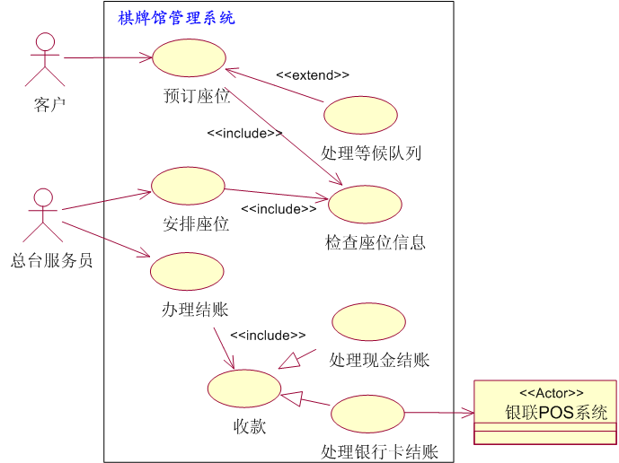
An example of Use case modeling

Slide 63
Use case model
Composed of different use case diagrams, each contains:
Actors
Use cases
Relationships between actors and use cases

Slide 64
Relationship between use cases
<<include>>
Include
<<extend>>
Extend
Generalization

Slide 65
<<include>>
Factor out steps common to several use cases into a separate use case which is then included.
The keyword include is used to include the behavior of another use case.
Including use case is called client use case, and the included use case is called supplier use case.

Slide 66
An “include” example
<<include>>
预定图书
检索图书信息

Slide 67
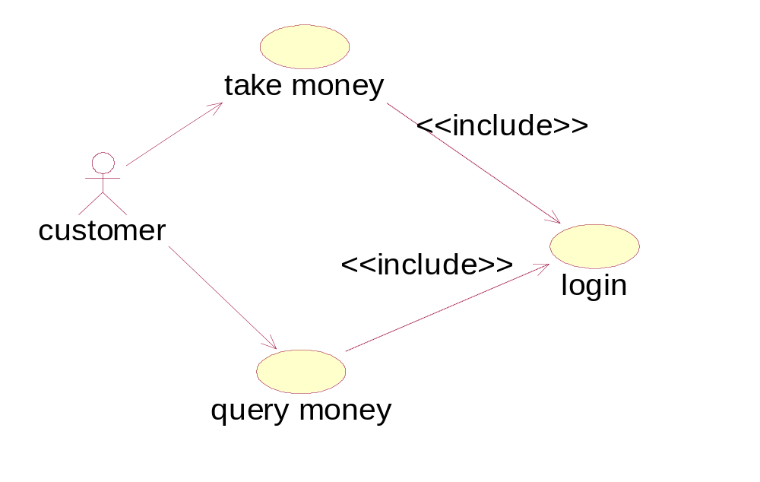
Another example

Slide 68
<<extend>>
<<extend>> provide a way to add new behavior to an existing (base) use case.
Thus We have Base use cases and extension use cases.
Base use case has extension points in an overlap on its flow of events- extension points occur between the steps in the flow of events.
The base use case is complete without the insertion segments – the extended use case does not know

Slide 69
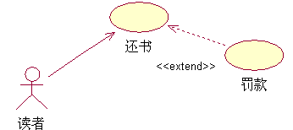
Extend example

Slide 70
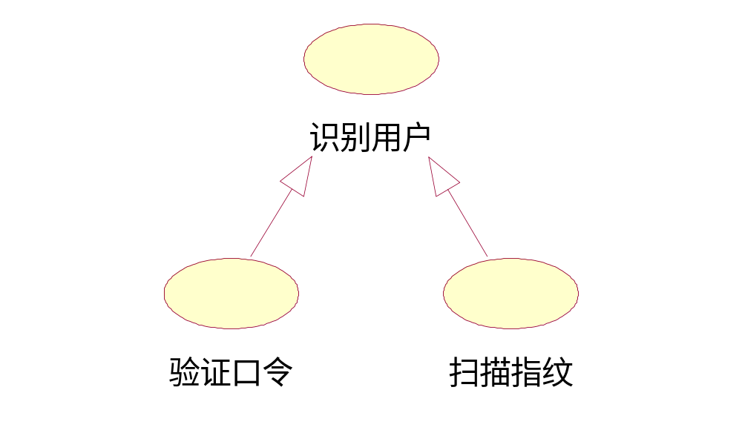
<< generalization >>
A generalization relationship is used to show that several actors or use cases have some commonality.

Slide 71
<< generalization >>---
A generalization relationship between a more general use case and a more specific use case.
Child use cases represent more specific forms of the parent
Find use case generalization:
- Factor out behavior common to one or more use cases into a parent use case.
- Find parent use cases and child use cases.
Note:
- The child use cases automatically inherits all features from its parent.

Slide 72
Refine (detail) Use case stepwise
With use case model, what to do next?

Slide 73
Refine (detail) Use case stepwise (continued)
A use case is a model (abstraction) of business, which describes what your system will do.
Use case model acts as a scope of the system.
How to continue developing?
You need to detail use case, i.e., use case specification: these details are written as the flow of events, which are scenarios of interaction between actor and system.

Slide 74
Refine (detail) Use case stepwise (continued)
An example: “borrow book”
Two common scenarios:
Scenario-1：successful ¹
Scenario-2：fail
Notes:
软件的卖点，初衷。人性最大的缺点就是 有时候走着走着 就忘记自己的初衷，走偏了。鉴定目标。

Slide 75
Refine (detail) Use case stepwise (continued)
The flow events of Scenario-1: primary scenario
1.Librarian inputs borrower’s information and submit it.
2.System validate information, if invalid, turn to extensio-2a;
3. Librarian enters books information and submit it.
4. System alter this book’s status
5. System process subscription information
5. System record borrowing information
6. System display successful information.

Slide 76
Refine (detail) Use case stepwise (continued)
The flow events of Scenario-2: alternate scenario.
2a:
2a1.
2a2.
……
we leave it out here for time consideration.

Slide 77
Refine (detail) Use case stepwise (continued)
Note:
四步曲：请求、验证、改变、反馈
主动结构
主语：actor, system
Scenarios only describe what actors and system to do, not how to do.(人话）
What to do: requirements

Slide 78
Refine (detail) Use case stepwise (continued)
Others details other than scenarios
Preconditions: The preconditions for a use case list any conditions that have to be met before the use case can start at all.
Postconditions: Postconditions are conditions that must always be true after the use case has finished executing.

Slide 79
Refine (detail) Use case stepwise (continued)
Use case specification template
  用例编号： 用例名：
  执行者：
    ××××（主）、××××（辅）
  前置条件：
  后置条件：
  涉众利益：
  基本路径：
  扩展路径：
  字段列表：
  业务规则：
  非功能需求：
  设计约束：
补充约束

Slide 80
formalizing Use case
Scenario is text-story, natural language has ambiguous disadvantage. It can be difficult to read and understand if the logic is complex, if there are a lot of alternate flows
For complex logic flow of events, we may need formal or semi-formal representation of use case.
Activity diagram is a prime semi-formal representation for use case.
A textual description of use case is required.

Slide 81
Activity diagram overview
An activity diagram is another way to model the flow of events.
An activity diagram shows you the same information as a textual flow of events would.
Activity diagrams are one of the most accessible UML diagrams since they use symbols similar to the widely-known flowchart notation;

Slide 82
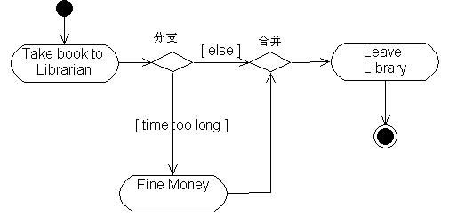

Slide 83
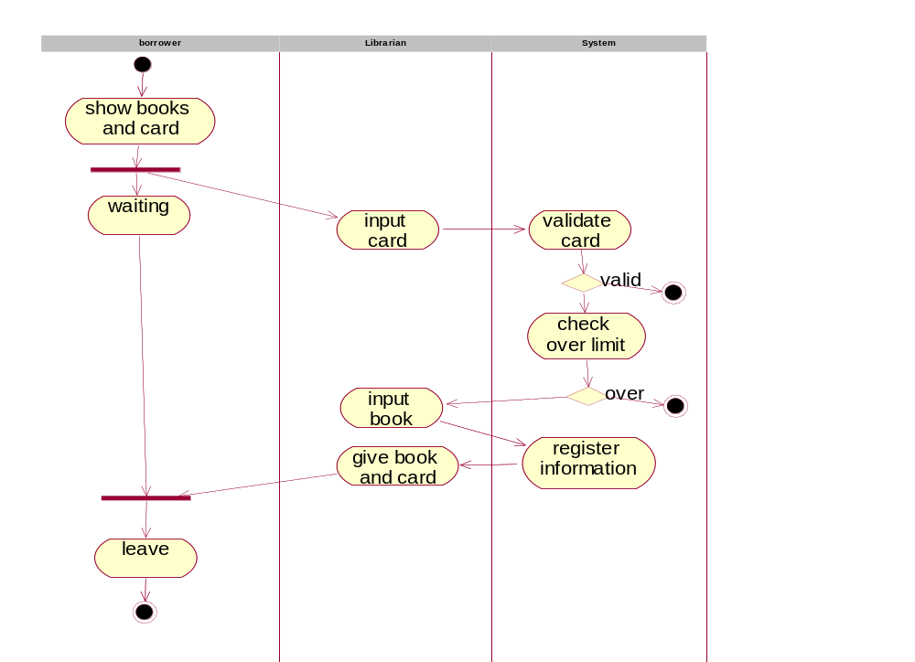

Slide 84
activity diagram elements
start state
end state
activity
(name of action)

Slide 85
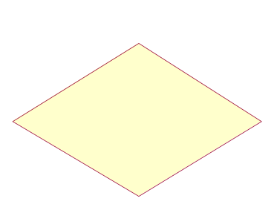
activity diagram elements---decision points
When modeling the workflow of a system, it is often necessary to show where the flow of control branches based on a decision point.
The transition from a decision point contain a guard condition.
The guard condition is used to determine which path from the decision point is taken.
Decisions along with their guard conditions allow you to show alternative paths through a work flow.

Slide 86
activity diagram elements--- swim lanes
Swim lanes may be used to partition an activity diagram.
This facility allows activity diagrams to show who has the responsibility for each activity in a process

Slide 87
activity diagram elements (continued)
Synchronization Bars
In a workflow there are typically some activities that may be done in parallel.
A synchronization bar allows you to specify what activities may be done concurrently.
A synchronization bar may have
  many incoming transition and one outgoing transition, or
  one incoming transition and many outgoing transitions.

Slide 88
Review
Software activities
  Vision
  Business modeling
  Requirements
  Analysis
  Design
  …
  Vision ---business modeling --- requirements… ( back tracking)

Slide 89
Review (continued)
三板斧
  Use case modeling
    Use case specification
  Class diagram ( from use case specification)
  Sequence diagram (from both)

Slide 90
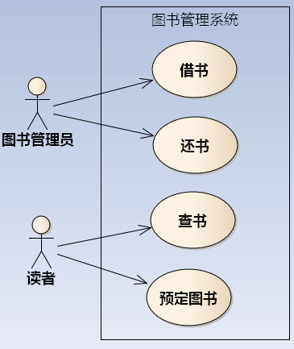
Review (continued)
Use case diagram

Slide 91
Review (continued)
Use case specification
Borrow book
1.Librarian inputs borrower’s information and submit it.
2.System validate information, if invalid, turn to extensio-2a;
3. Librarian enters books information and submit it.
4. System alter this book’s status
5. System process subscription information
5. System record borrowing information
6. System display successful information.

Slide 92
Review (continued)
Use case specification template
  用例编号： 用例名：
  执行者：
    ××××（主）、××××（辅）
  前置条件：
  后置条件：
  涉众利益：
  基本路径：
  扩展路径：
  字段列表：
  业务规则：
  非功能需求：
  设计约束：
补充约束

Slide 93
Review (continued)
Class diagram
Sequence diagram

Slide 94
Modeling “Entity” and its relationship
When human do business, they need or produce entities.
OO = entity + entity + messages
The goal of modeling business is to identify entities.
In UML, class/object diagram is used to model entity and its relationship. Class is at the heart of OO system.

Slide 95
Class notation in UML
A class is a description of a set of objects that share the same attributes, operations, relationships, and semantics.
  An object is an instance of a class
Notation : a class is represented using a rectangle with three compartments.
In OO, object represents an entity in real world.

Slide 96
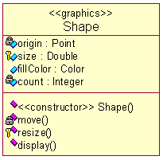
Class notation in UML (continued)
Class name
attributes
operations

Slide 97
Class notation in UML (continued)
Visibility
visibility
UML
Rose
private
-
protected
#
public
+

Slide 98
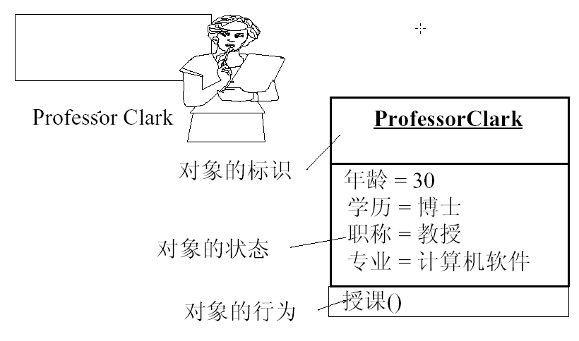
Object notation in UML
Brings class to life: object diagram, object is at heart of OO system at runtime.
Object is an instance of a class

Slide 99
How to identify classes?
A good place to start when finding classes is the flow of events for your use cases. Looking at the nouns in the flow of events will let you know what some of the classes are.

Slide 100
How to identify classes?(con’t)
Borrow book:
1.Librarian inputs borrower’s information and submit it.
2.System validate information, if invalid, turn to extensio-2a;
3. Librarian enters books information and submit it.
4. System alter this book’s status
5. System process subscription information
6. System record borrowing information
7. System display successful information.

Slide 101
How to identify classes?(con’t)
Borrow book:
Identifying objects
  borrower’s information
  Book
  Subscription information
  Borrowing information

Slide 102
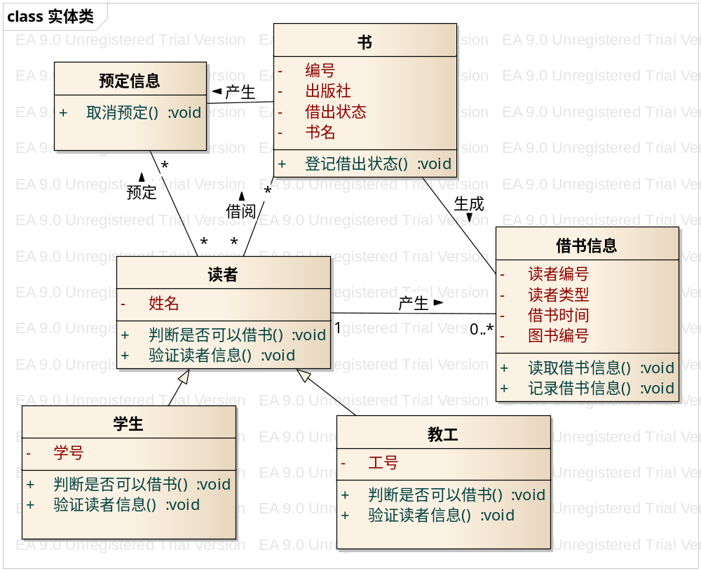
How to identify classes?(con’t)

Slide 103
Class relationship
Relationship
  Dependency
  Generalization
  Association
  Aggregation
  Composition

Slide 104
Dependency
Dashed arrow
driver
park
parking

Slide 105
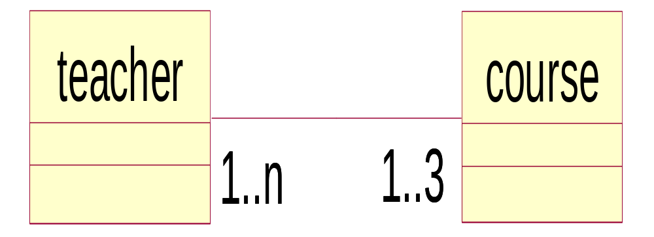
Association relationship--structure
connecting line
Teaching

Slide 106
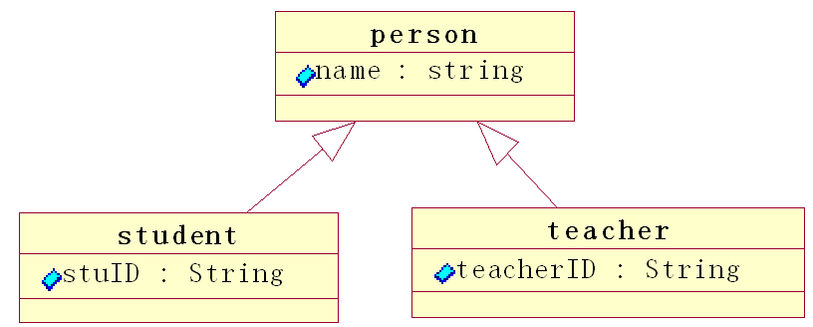
Generalization--inheritance
Empty arrow

Slide 107
Aggregation
Empty diamond arrow
University
School

Slide 108
Composition
filled diamond arrow
window
menu
button

Slide 109
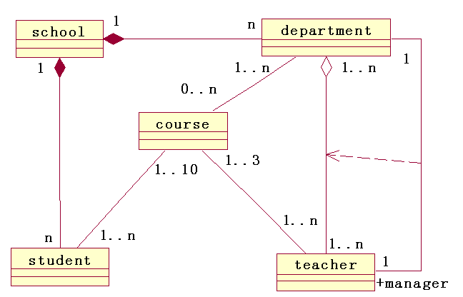
An example

Slide 110
Modeling interaction between objects
modeling “business” form dynamic perspective: how to realize use case.
  Sequence diagram
  Communication diagram
Here we focus on sequence diagram.
SD capturing the order of interactions between objects, and the responsibilities of each object

Slide 111
A First Look at Sequence Diagrams
Illustrates how objects interacts with each other.
Emphasizes time ordering of messages.
Can model simple sequential flow, branching, iteration, recursion and concurrency.

Slide 112
A First Look at Sequence Diagrams (con’t)
Borrow book:
1.Librarian inputs borrower’s information and submit it.
2.System validate information, if invalid, turn to Scenario-2;
3. Librarian enters books information
4. System alter this book’s status
5. System record borrowing information
6. System display successful information

Slide 113
A First Look at Sequence Diagrams (con’t)
Borrow book:
Identifying objects
  borrower’s information
  Book
  Borrowing information

Slide 114
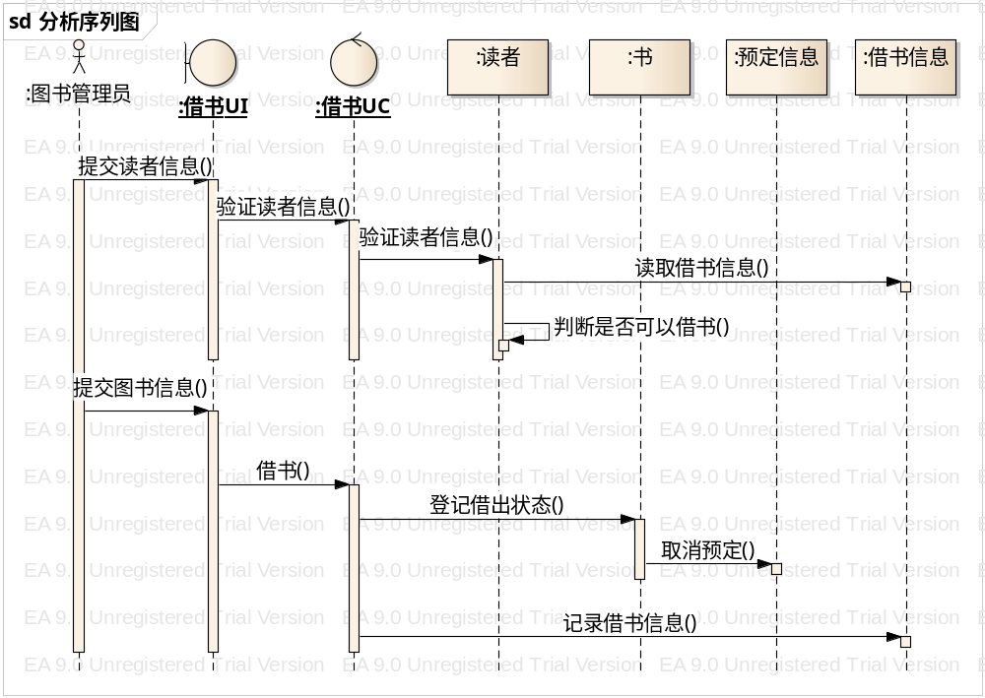
A First Look at Sequence Diagrams (con’t)

Slide 115
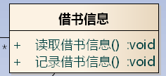


MVC Pattern
Model
View
Control

Slide 116
A Sequence Diagram analysis
X-Axis (objects)
member:
LibraryMember
book:Book
:Book
Copy
borrow(book)
Object
Life Line
Y-Axis (time)
ok = mayBorrow()
message
Activation box
[ok] borrow(member)
setTaken(member)
condition

Slide 117
Object
Object naming:
  syntax: [instanceName][:className]
  Name classes consistently with your class diagram (same classes).
  Include instance names when objects are referred to in messages or when several objects of the same type exist in the diagram.
The Life-Line represents the object’s life during the interaction
myBirthdy
:Date

Slide 118
Messages
An interaction between two objects is performed as a message sent from one object to another (simple operation call, Signaling, RPC)
If object obj₁ sends a message to another object obj₂ some link must exist between those two objects (dependency, same objects)

Slide 119
Messages (Cont.)
A message is represented by an arrow between the life lines of two objects.
  Self calls are also allowed
  The time required by the receiver object to process the message is denoted by an activation-box.
A message is labeled at minimum with the message name.
  Arguments and control information (conditions, iteration) may be included.

Slide 120
Return Values
Optionally indicated using a dashed arrow with a label indicating the return value.
  Don’t model a return value when it is obvious what is being returned, e.g. getTotal()
  Model a return value only when you need to refer to it elsewhere, e.g. as a parameter passed in another message.
  Prefer modeling return values as part of a method invocation, e.g. ok = isValid()

Slide 121
Synchronous Messages
Nested flow of control, typically implemented as an operation call.
  The routine that handles the message is completed before the caller resumes execution.
:A
:B
doYouUnderstand()
return (optional)
Caller Blocked
yes

Slide 122
Object Creation
An object may create another object via a <<create>> message.
Preferred
:A
:B
:A
<<create>>
<<create>>
:B
Constructor

Slide 123
Object Destruction
An object may destroy another object via a <<destroy>> message.
  An object may destroy itself.
  Avoid modeling object destruction unless memory management is critical.
:A
:B
<<destroy>>

Slide 124
Control information
Condition
  syntax: ‘[‘ expression ’]’ message-label
  The message is sent only if the condition is true
  example:
Iteration
  syntax: * [ ‘[‘ expression ‘]’ ] message-label
  The message is sent many times to possibly multiple receiver objects.
[ok] borrow(member)

Slide 125
Control Information (Cont.)
Iteration examples:
:CompoundShape
:Shape
:Driver
:Bus
draw()
*draw()
*[until full] insert()
The syntax of expressions is not a standard

Slide 126
Control Information (Cont.)
The control mechanisms of sequence diagrams suffice only for modeling simple alternatives.
  Consider drawing several diagrams for modeling complex scenarios.
  Don’t use sequence diagrams for detailed modeling of algorithms (this is better done using activity diagrams, pseudo-code or state-charts).

Slide 127
Example
Printing A
Document
Active object
:PrintServer
:Queue
:Printer
Proxy
Client
print(doc,client)
enqueue(job)
job=dequeue()
Repeated forever with 1 min interludes
[job]print(job.doc)
status
[job] done(status)

Slide 128
Summary of modeling with UML
UML, per se is complex
Miller rule: 2+-7
Vilfredo Pareto 2/8 principle
So we need master, practically less then, 20%

Slide 129
Summary of modeling with UML
Use case: function models, modeling business
  Drive other model
Activity diagram: formalize use case
Class diagram: structure
  May most important
Sequence diagram: behavior in terms of interaction.
  May secondly most important
  Complement the class diagram
    Find missing objects
    Detect class’s operations

